Slide 1


Slide 2
Creative Force
Founded: 2020
We want to make fun and engaging games that are creative and take it to the next level.

Slide 3

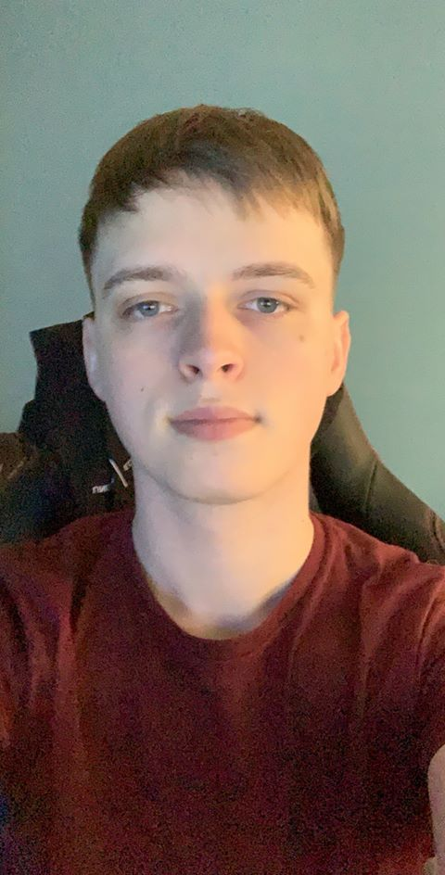


Company Development Team
Calum – Team Leader
Experience working in large teams, programmer.
Pawel – Level Designer
Experienced programmer, participated in GameJams
Brodie – Programmer
Experienced programmer, participated in GameJams
Samuel – 3D Artist
Experienced programmer, participated in GameJams

Slide 4
CyberFocus
CyberFocus is a first person, parkour, time bending experience players will find fun and creative.

Slide 5
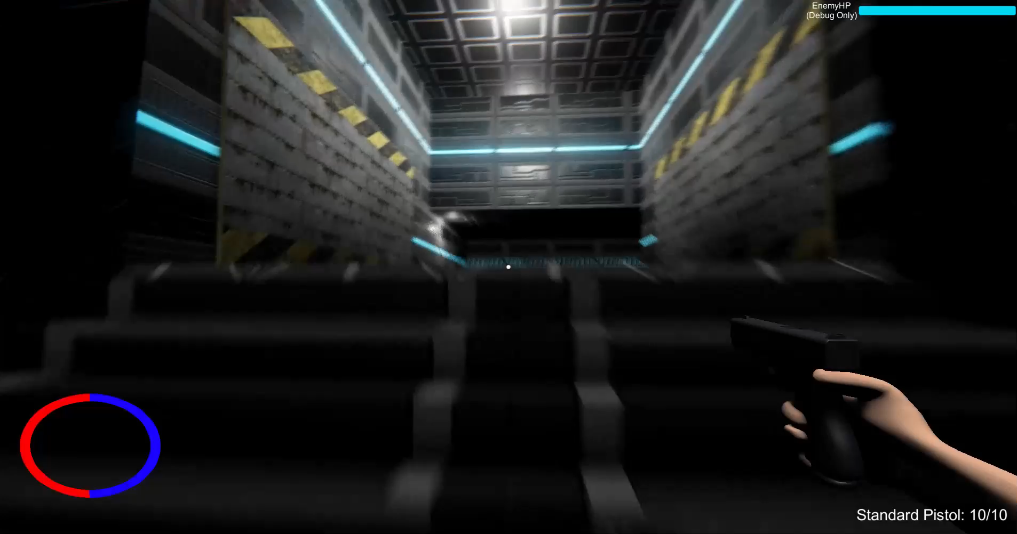
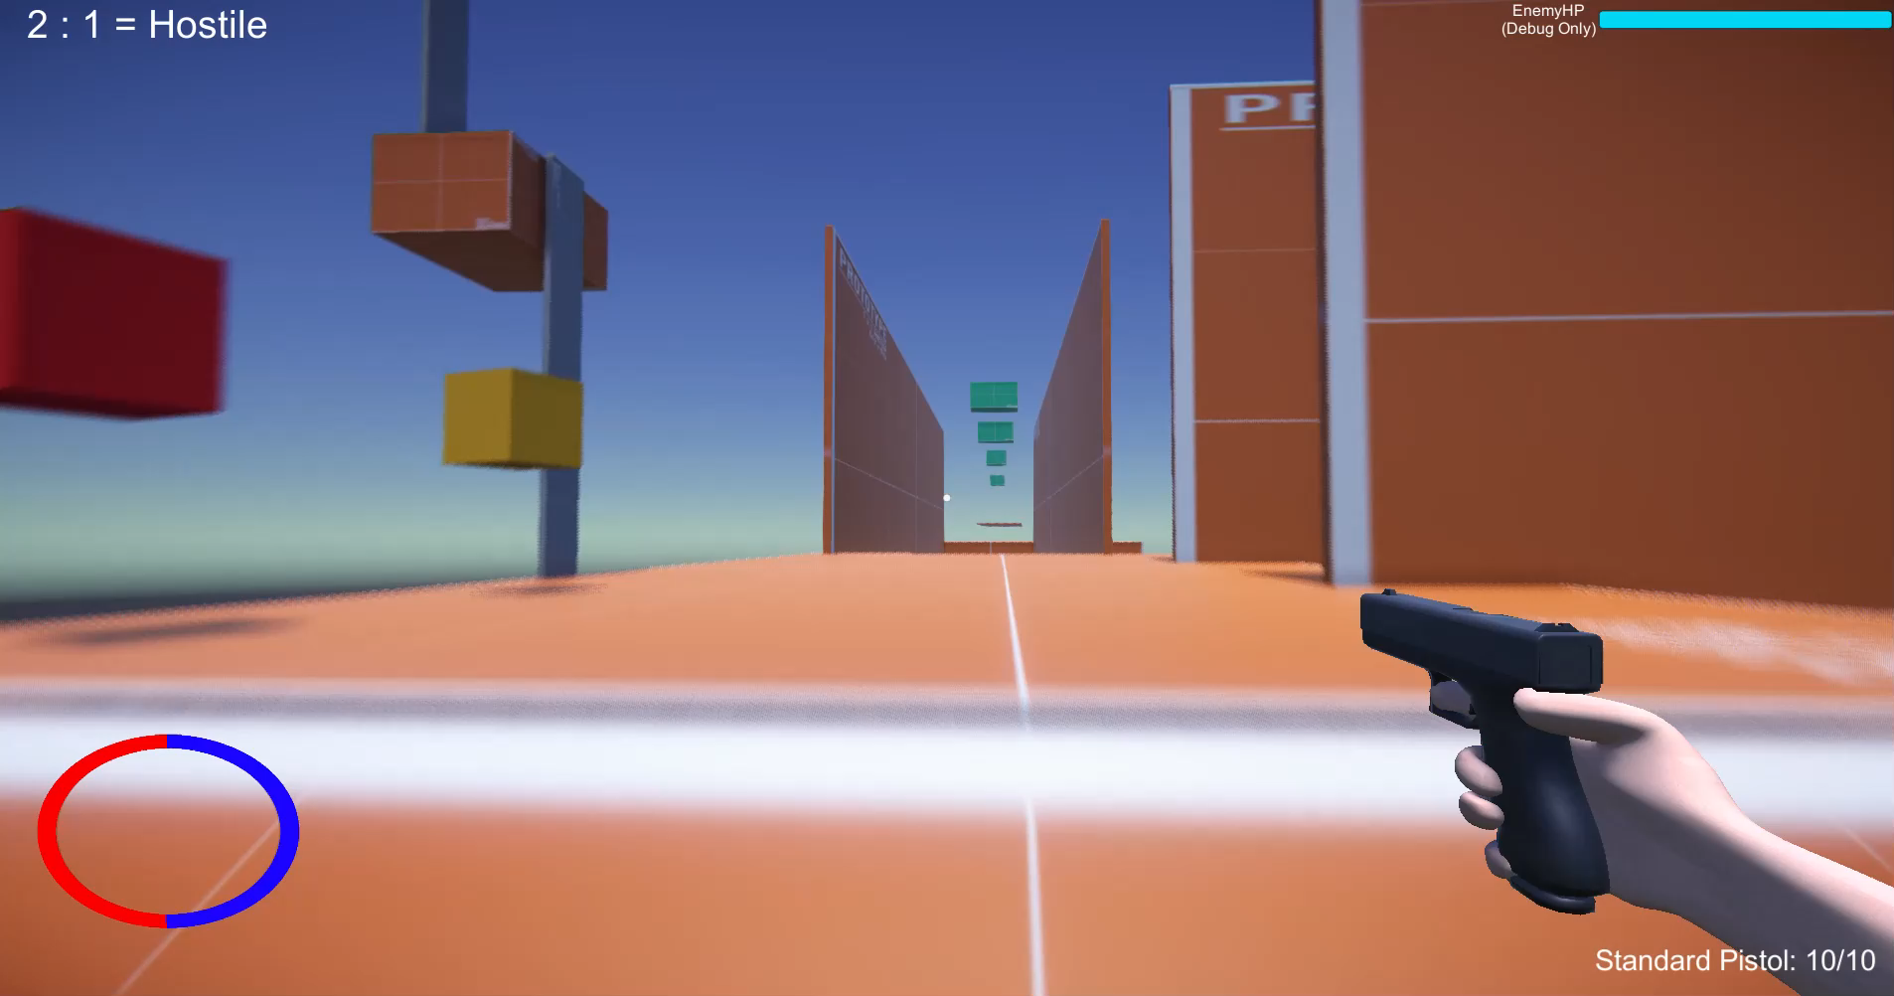
Parkour
What players expect to be in a parkour game.
Hook to propel player

Slide 6
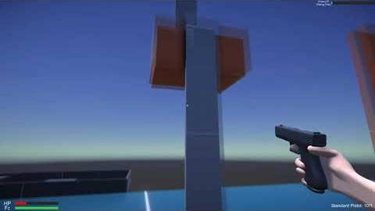
Time Control
The world slows around the player
Bullets, enemies slow for satisfying results.
Gifs here
Notes:
Backstory: set in the future, the player is designed by a company that specialises in cyborg technology. With them being a cyborg, they have the ability to wall run, slow down time and parkour.
In the next slide we will discuss the 3 phase model we are creating for the player to follow and understand the game better.

Slide 7
Combat
Real time
Bullets slow down (similar to SuperHot)
Parkour with this combat to produce enjoyable results.
Gifs here
Notes:
Backstory: set in the future, the player is designed by a company that specialises in cyborg technology. With them being a cyborg, they have the ability to wall run, slow down time and parkour.
In the next slide we will discuss the 3 phase model we are creating for the player to follow and understand the game better.

Slide 8
Marketing Plan
Conference + Trade Shows | Publisher to help with funding
Trailers | Own YouTube Channel
Community Building | Twitter/YouTube/Discord
PR + Marketing | Contractor -> Publisher
Notes:
Backstory: set in the future, the player is designed by a company that specialises in cyborg technology. With them being a cyborg, they have the ability to wall run, slow down time and parkour.
In the next slide we will discuss the 3 phase model we are creating for the player to follow and understand the game better.

Slide 9
Production Timeline
June
Character Movement + Wall running begin
Environment placement
Basic parkour
July
Wall Running
Hook Mechanic
Slow down time Enemies
August
All features to be polished Main level finished
Community Building
PR + Marketing
September
Further polish
Community Building
PR + Marketing
Notes:
Backstory: set in the future, the player is designed by a company that specialises in cyborg technology. With them being a cyborg, they have the ability to wall run, slow down time and parkour.
In the next slide we will discuss the 3 phase model we are creating for the player to follow and understand the game better.

Slide 10
Budget
Game Development | £25,000
Coding | £4,166
Localisation
QA
PR + Marketing PR, Targeted Advertising, Marketing Spend
Porting
TOTAL
Notes:
Backstory: set in the future, the player is designed by a company that specialises in cyborg technology. With them being a cyborg, they have the ability to wall run, slow down time and parkour.
In the next slide we will discuss the 3 phase model we are creating for the player to follow and understand the game better.

Slide 11
Funding
Studio Investment | £££££
Publisher | £25,000
Us
TOTAL
Notes:
Backstory: set in the future, the player is designed by a company that specialises in cyborg technology. With them being a cyborg, they have the ability to wall run, slow down time and parkour.
In the next slide we will discuss the 3 phase model we are creating for the player to follow and understand the game better.

Slide 12
Recap
What is it?
Why is it fun?
Why would someone want to play it?
Notes:
Backstory: set in the future, the player is designed by a company that specialises in cyborg technology. With them being a cyborg, they have the ability to wall run, slow down time and parkour.
In the next slide we will discuss the 3 phase model we are creating for the player to follow and understand the game better.

Slide 13
Looking For
Development Funding
Store support
Marketing support
A partner who understands us and our game

Slide 14
Thank You
Contact:
creativeforce532@gmail.com

